Slide 1
﷽

Slide 2
HARMONIC MEAN

Slide 3
Harmonic mean
Definition:
Harmonic mean is given by the reciprocal of the arithmetic mean of the reciprocal of the observations.
Harmonic mean is used to calculate the average of speed

Slide 4

Harmonic mean
MATHEMATICAL FORMULA
=> HM = $x1,x2,x3……..xn$
=> HM =$\frac{\frac{1}{x1}+\frac{1}{x2}+\frac{1}{x3}+\frac{1}{x4}………….+\frac{1}{xn}}{n}$
=> HM = $\frac{n}{\left(\frac{1}{x1}+\frac{1}{x2}+\frac{1}{x3}+\frac{1}{x4}………….+\frac{1}{xn}\right)}$
=> HM =$\frac{n}{\sum{\left(\frac{1}{x}\right)}}$

Slide 5

Example
Find the HM of 4,6,10?
Solution:
Given 4,6 and 10
HM = 4,6,10
HM = $\frac{1}{4} \frac{1}{6} \frac{1}{10}$
HM =$\frac{\frac{1}{4}+\frac{1}{6}+\frac{1}{10}}{3}$
HM = $\frac{3}{\sum{\left(\frac{1}{4}+\frac{1}{6}+\frac{1}{10}\right)}}$
HM =$\frac{3}{\sum{\left(0.51667\right)}}$
HM = 5.813
Therefore the HARMONIC mean =5.813

Slide 6



Harmonic mean
Find the H.M of the following data:15,20,21,22,26 and 29
Solution: Given 15,20,21,22,26 and 29
we know that HM =$\frac{n}{\sum{\left(\frac{1}{x}\right)}}$
n is total of 6
$\sum{\left(\frac{1}{x}\right)}$ = 0.28268
HM = $\frac{6}{0.28268}$
HM = 21.22507
Harmonic mean =21.2
$\sum{as know a sigma}$
Used for sum of all vales
$$\sum{x1+x2+x3……………+xn}$$
$$x$$ | $$\frac{1}{x}$$
15 | 0.06667
20 | 0.05000
21 | 0.04762
22 | 0.04545
26 | 0.03846
29 | 0.03448
N = 6 | $\frac{n}{\sum{\left(\frac{1}{x}\right)}}$ 0.28268

Slide 7

Discrete Series:
Harmonic mean of a discrete series is given by:
Mathematical formula
HM =$\frac{n}{\sum{\left(\frac{f}{x}\right)}}$

Slide 8



Example:
Find the HM for the following distribution”
Solution:
HM =$\frac{n}{\sum{\left(\frac{f}{x}\right)}}$
HM =$\frac{50}{4.67}$
HM = 10.71
Harmonic mean = 10.71
Therefore , the Harmonic mean =10.71
$$x$$ | 4 | 8 | 15 | 20 | 16
$$f$$ | 5 | 10 | 20 | 8 | 7
$$x$$ | $$f$$ | $$\frac{f}{x}$$
4 | 5 | 1.25
8 | 10 | 1.25
15 | 20 | 1.33
20 | 8 | 0.40
16 | 7 | 0.44
 | n = 50 | $\frac{n}{\sum{\left(\frac{f}{x}\right)}}$ 4.67

Slide 9

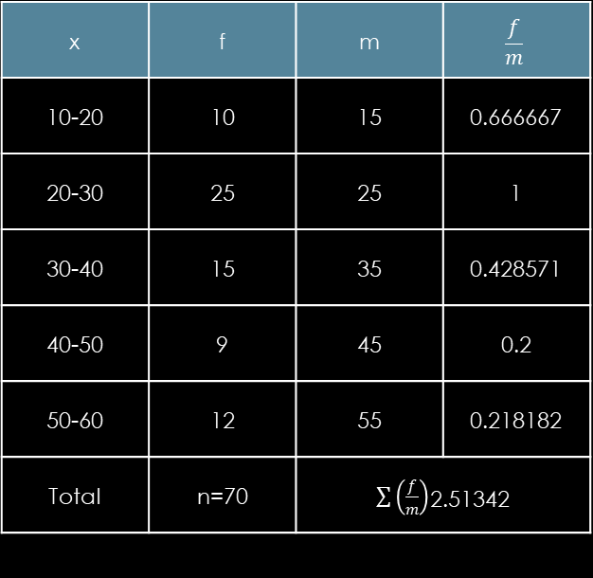
Example:
Find the HM of the following data:
solution:
H.M = $\frac{n}{\sum{\left(\frac{f}{m}\right)}}$
Here we find x by finding mid point from
class interval such as
10-20 → $\frac{10+20}{2}$ = 15
20-30 → $\frac{20+30}{2}$ = 25 And so on
N is total frequency
$\sum{\left(\frac{f}{m}\right)}$ = 2.51342
H.M = $\frac{n}{\sum{\left(\frac{f}{m}\right)}}$ → H.M = $\frac{70}{2.51342}$ → HM = 27.85
Therefore the Harmonic mean in continuous series = 27.85
Class interval | 10-20 | 20-30 | 30-40 | 40-50 | 50-60
Frequency | 10 | 25 | 15 | 9 | 12
Class interval | 10-20 | 20-30 | 30-40 | 40-50 | 50-60
Frequency | 10 | 25 | 15 | 9 | 12
x | f | m | $$\frac{f}{m}$$
10-20 | 10 | 15 | 0.666667
20-30 | 25 | 25 | 1
30-40 | 15 | 35 | 0.428571
40-50 | 9 | 45 | 0.2
50-60 | 12 | 55 | 0.218182
Total | n=70 | $\sum{\left(\frac{f}{m}\right)}$2.51342
x | f | m | $$\frac{f}{m}$$
10-20 | 10 | 15 | 0.666667
20-30 | 25 | 25 | 1
30-40 | 15 | 35 | 0.428571
40-50 | 9 | 45 | 0.2
50-60 | 12 | 55 | 0.218182
Total | n=70 | $\sum{\left(\frac{f}{m}\right)}$2.51342

Slide 10

Properties of Harmonic mean
If all the values assumed by a variable are constant, say k, then the Harmonic Mean is also k
If there are two groups containing n₁ and n₂ observation with respective harmonic means as H1 and H2 , then combined harmonic mean is given by:
Mathematical formula
HM =$\frac{n1+n2}{\frac{n1}{H1} +\frac{n2}{H2}}$

Slide 11

Example:
If there are two groups with 75 and 65 as harmonic means and containing 15 and 13 observation then the combined HM is given by:
solution:
n₁ = 15 n₂ = 13
H₁ = 75 H₂ = 65
using formula
HM =$\frac{n1+n2}{\frac{n1}{H1} +\frac{n2}{H2}}$
put value
HM =$\frac{15+13}{\frac{ 15}{75} +\frac{13}{65}}$
HM = 70

Slide 12

Properties of harmonic means
Harmonic means of 1,1/2,1/3,………1/n is given by:
Mathematical formula:
HM= $\frac{2}{n+1}$
example:
1,$\frac{1}{2},\frac{1}{3},\frac{1}{4},\frac{1}{5}$
solution:
n = 5
HM = $\frac{2}{n+1}$
put value of n
HM = $\frac{2}{5+1}$ => HM = $\frac{2}{6}$
HM = $\frac{1}{3}$

Slide 13

Properties of harmonic means
In order to calculate average speed use harmonic mean. The harmonic mean of two number is given by
Mathematical formula:
HM = $\frac{2xy}{x+y}$

Slide 14

Example:
An aeroplane files from A to B at the rate of 500 Km/ hour and comes back from B to A at rate of 700 km/hour . The average speed of the aeroplane is :
SOLUTION:
x = 500 y = 700
using formula
HM = $\frac{2xy}{x+y}$
put value of x and y
HM = $\frac{2∗500∗700}{500+700}$ => HM = 583.33

Slide 15
Importance:
Harmonic mean is useful in situations where the average rate of change or speed needs to calculated.
It is commonly used in various fields such as physics, economics, and engineering.
For example:
It is used to calculate average gas mileage, average speed, and average resistance in parallel circuits.

Slide 16
Characteristics:
The harmonic mean is always less than or equal to the arithmetic mean.
It is influenced more by smaller numbers in the set than by large numbers
The harmonic mean of n positive numbers is only defined if all numbers are nonzero.

Slide 17
Limitations:
It is sensitive to extreme values, particularly very small numbers.
If may not be suitable for datasets with negative numbers or nonzero.

Slide 18
Relationship between AM, GM, HM
For constant observations
AM = GM =HM
For distinct observations
AM > GM > HM
Therefore, AM ≥ GM ≥ HM

Slide 19
Example constant observation
If the AM and GM for 10 observation are both 15, then the value of HM is :
Less than 15 (b) more then 15 (c) 15 (d) cannot be determined

Slide 20
Relationship between AM, GM, HM
GM² = AM * HM
This relationship holds true only for positive observations.

Slide 21

Example
If the AM and HM for two numbers are 5 and 3.2 respectively then the GM will be :
solution:
AM = 5 HM = 3.2
GM = ?
using formula
GM² = AM * HM
GM = $\sqrt{AM ∗HM}$
GM = $\sqrt{5 ∗3.2}$ => GM = $\sqrt{16}$
GM = 4

Slide 22
Any Question
THANK YOU

